Slide 1


Application Security. Simplified.

Slide 2

Our Mission
Our mission is to provide outstanding customized application security services to our clients and tailor-made solutions to cater their needs with the help of our trusted reliable partner network. Enacting mature approach by working side by side and increasing the ROI of our clients.
Our Vision
Enhancing organizations cybersecurity posture by reducing the risk with a pragmatic way of innovation aiming to predict the future precisely by creating it flawlessly.

Slide 3




About Entersoft
SECURITY ASSESSMENTS
World-class certified OSCP hackers &
CREST certified team
Methodical protection against malicious attacks
PRAGMATIC APPROACH
‘Hackers Mindset’ to identify threats & professional approach to enhance your organization’s first line of defense
360-degree support to strengthen your organization’s security posture
EXTENSIVE SUPPORT

Slide 4







Our Capability
6000+
Security Bugs Fixed
3000+
Apps tested
350+
Happy Customers
A maximum of 1 hour to fix any bug
We reviewed millions of lines of code
Lightning Speed Assessments

Slide 5

Core Offerings
Application Security Assessments
DAST
SAST
IAST
Infrastructure Security Assessments
Cloud Security Assessments
DevSecOps
Web Application
Mobile Application
API
Thick Client
Source Code Review
Software Composition Analysis
Reverse Engineering
Customized Assessments
Standards we adhere to
OWASP - 2017
SANS – 25
WASC - 40
CVSS - 3.1

Slide 6
Other Offerings
Advanced Managed Services
Contemporary Services
Consulting, Governance, Risk & Compliance
Products & Solutions
Red Teaming as a Service
Managed Detection and Response
SOC
Threat Monitoring & Hunting
Industrial IoT Assessments
Blockchain Security (Smart Contract Audits – Both Static & Dynamic)
vCISO
HIPPA, PCI, ISO, etc.
Staffing Service
API Scanner
Enprobe – VMS (Vulnerability Management System)
Training Solutions
Dark Web Monitoring
Smart Auditor

Slide 7







The way we work
Automated Scripts for known patterns
Advanced threat detection and vulnerability assessments with our in-house proprietary tools and scripts.
Using Automation 40%
Manual 60%
Automated and Custom scripts combined with Open Source tools
VMS
Multi-level information extraction regarding target application(s)
Understand the Infrastructure
Identify business critical components or assets
Design business test cases to attack
Detailed Report
Testing target applications for common vulnerabilities
Dynamic screen capture of all checks performed
Target Exploitable & weak entry points
Re-validation of results and further tool enhancement
Notes:
Understand the Infrastructure (Application, Cloud, Network, Servers)
Using automation, we use commercial and custom scripts.
Mentions CVSS Standards
Identifying authorization & authentication,…as the tools don’t find the shell upload test cases through automated scanners

Slide 8

(In Depth) Application Penetration Testing Methodology
Application walk through
Threat Modelling
Automated test on known Patterns
to identify business test cases to attack
to identify Critical data and core competencies
run our automated scripts to satisfy the generic security assessment
Manual Attack
on the business-critical components and targeting exploitable and weak entry points
Support to Fix
Code Samples & POC Videos
Classify vulnerabilities
the vulnerabilities and retest to verify the existence once fixed.
based on their severity and clearly define the business impact which can be caused
which will help to instil security culture into the Dev team and ease the process of fixing vulnerabilities

Slide 9
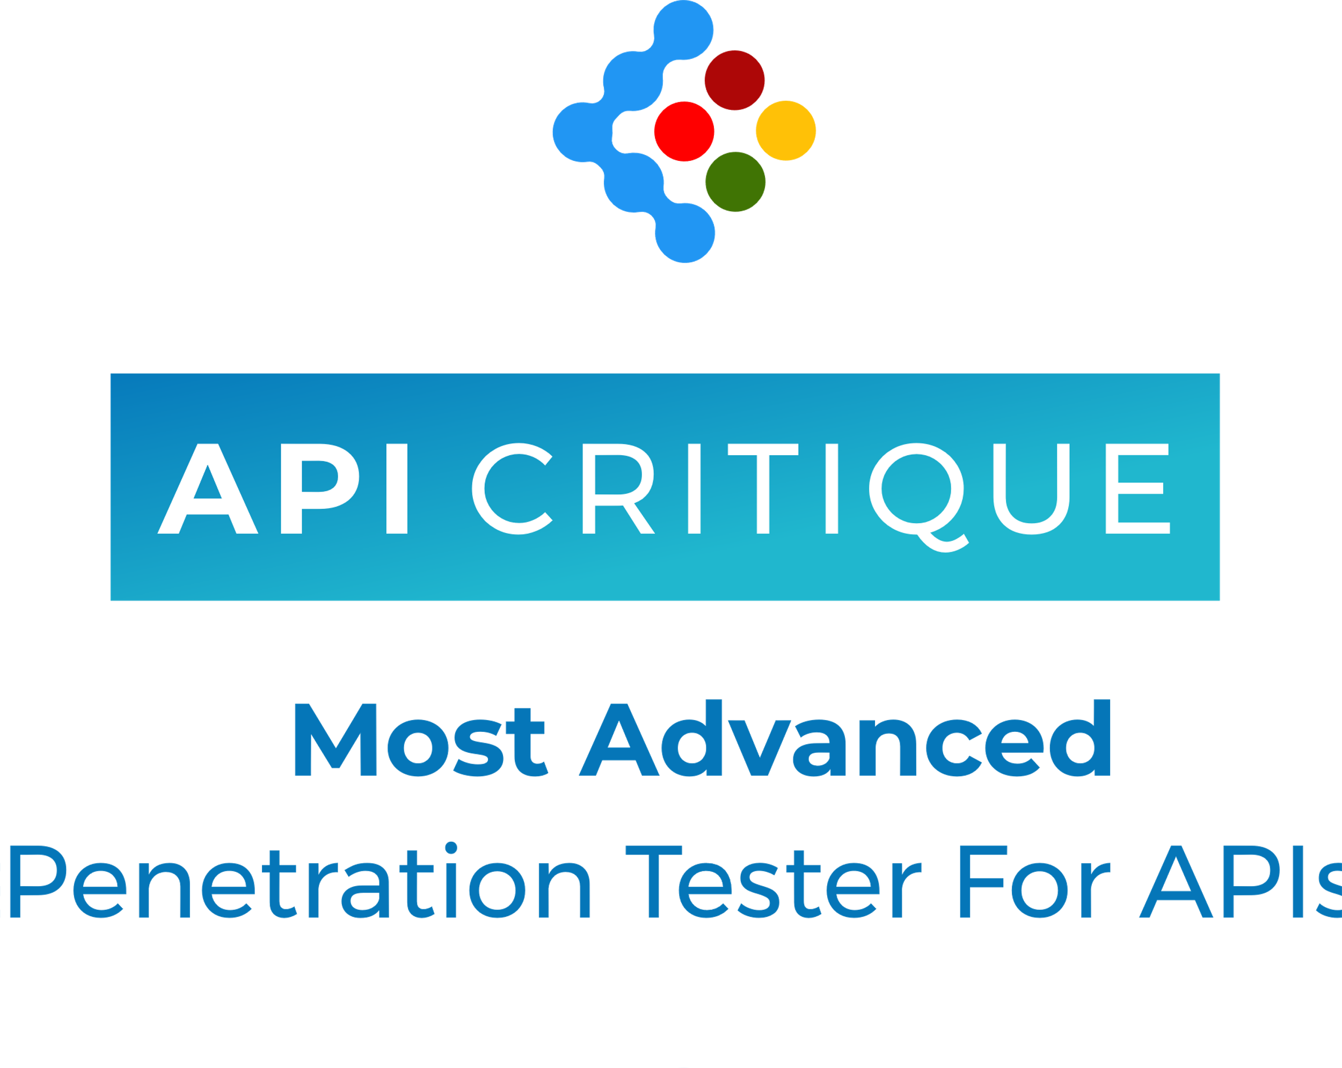
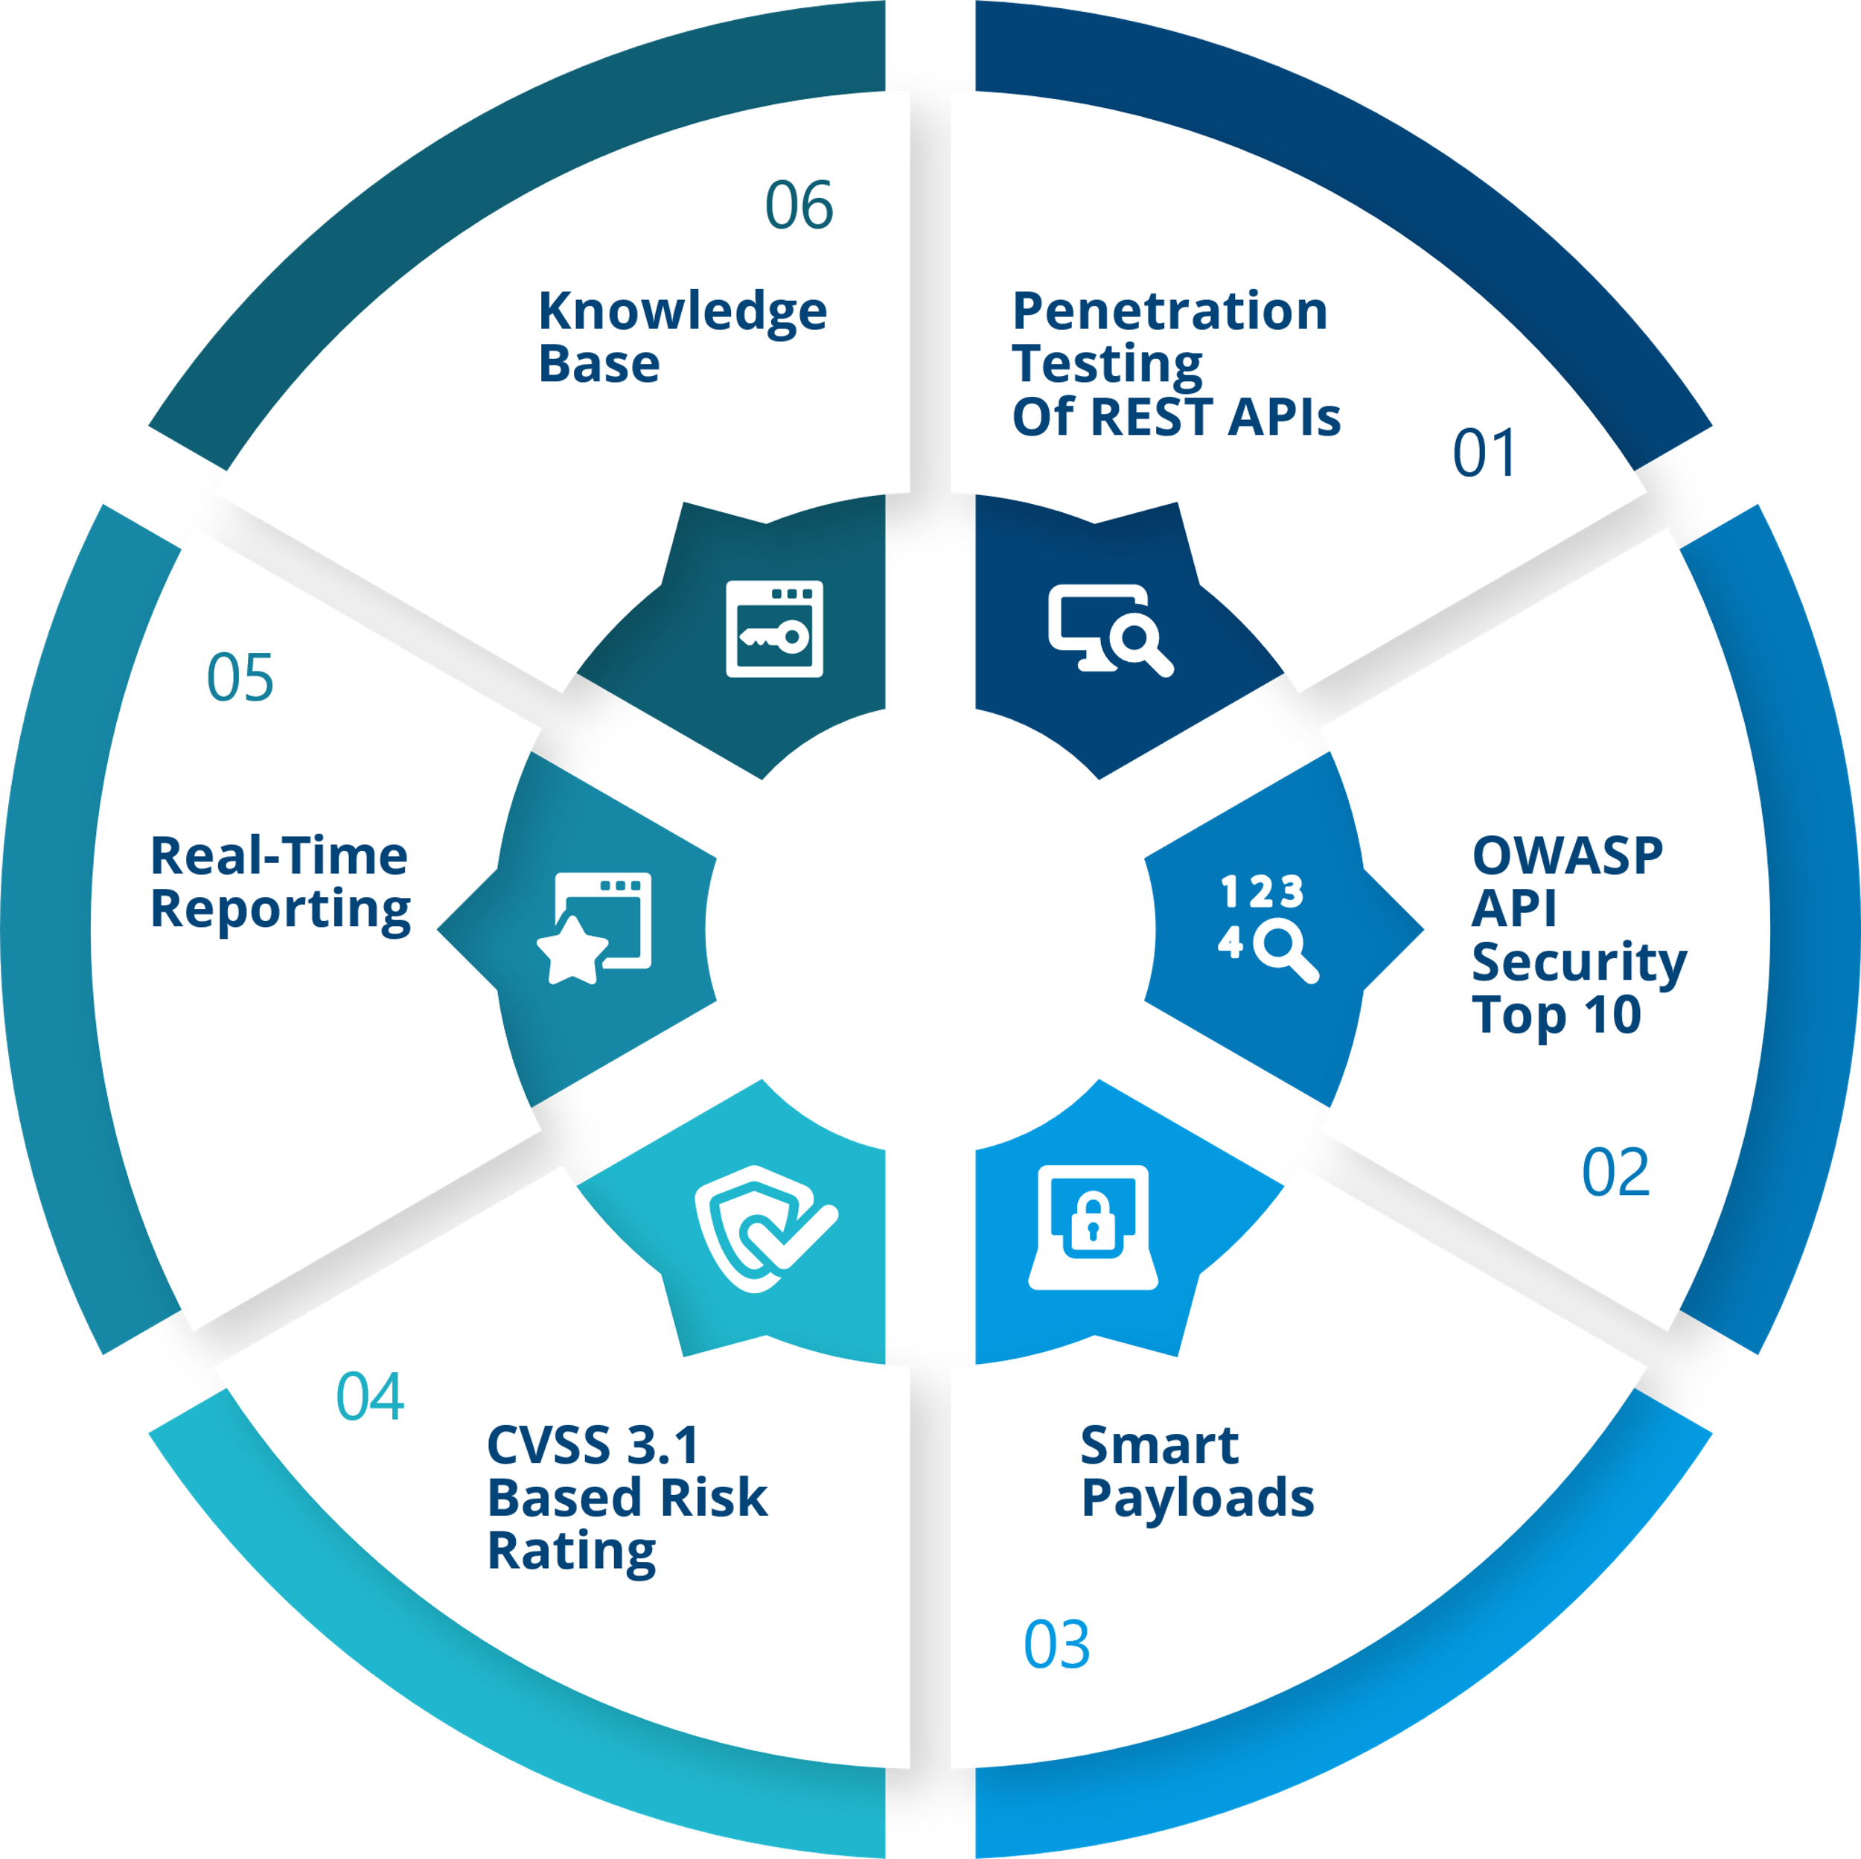
THE MOST COMPREHENSIVE SECURITY SOLUTION FOR YOUR APIS
With API CRITIQUE, you can now implement DevSecOps with ease and save valuable time and effort for your development team and help create a secure applications portfolio. With our smart-payload algorithm, our vulnerability assessments and penetration testing are lightning fast and provide real time visibility of vulnerabilities. Secure your APIs now and protect your business from cybercriminals.

Slide 10









Few of our Happy & Secure Customers

Slide 11







Leaving our mark
FINTECH OF THE YEAR & EXCELLENCE IN APP SECURITY
EXCELLENCE IN
CYBER SECURITY
BEST INNOVATION IN
CYBER-SECURITY &
ANTI-FRAUD
AMONG TOP 50 ENTERPRISE PRODUCT STARTUPS IN INDIA IN 2016
AMONG TOP 25 STARTUPS SELECTED
FOR ACCELERATION
IN GOOGLE U
AMONG TOP 8 STARTUPS SELECTED
IN FINTECH SUPERCHARGER
ACCELERATOR IN HONG KONG
AMONG TOP 5 STARTUP FINALISTS IN CONNECT EXPO 2016

Slide 12


GEOGRAPHICAL PRESENCE
Headquarters
Global Offices
BENGALURU
AUSTRALIA
ISRAEL
3RD FLOOR, NO.44/A, DATTA PRABHAS,
1ST MAIN ROAD, 3RD PHASE, JP NAGAR,
BENGALURU, KARNATAKA - 560078
INDIA
375 WICKHAM TERRACE
SPRING HILL QLD 4000
H'HADAS ST 21,
TEL MOND,
ISRAEL
+61 7 3839 4159
+91 9108735002
+972 54 2561200
HYDERABAD
MEXICO
HONG KONG
162. ROAD NO 72, PRASHASHANT NAGAR,
JUBILEE HILLS, HYDERABAD,
TELANGANA - 500033
INDIA
375 WICKHAM TERRACE
SPRING HILL QLD 4000
WAH YUEN BUILDING,
149 QUEEN'S ROAD CENTRAL,
HONG KONG
+61 7 3839 4159
+852 8121 0935
+91 40 23332299

Slide 13

QUESTIONS?
“
”
One single vulnerability is all an attacker needs!!!
Contact our security experts today!
info@entersoftsecurity.com

